Slide 1

Raffinement de l’architecture physique McBIM
Version 1.0 – 03/05/2018

Slide 2
Présentation du document
Le 12/03, réunion McBIM sur la structure générale du projet
Le 12/04, réunion LAAS sur le raffinement de l’architecture physique
But du document : présentation de la proposition d’architecture du LAAS
Présentation issue du document de travail entre CRAN et LAAS:
  Commentaires de couleur du CRAN (rouge: Non, vert: sûrement, bleu : on se sait pas)

Slide 3


Rappel des objectifs du projet McBIM
F2
FT2 : Mesure de constantes physiques du truc et du réseaux de trucs / de l’environnement du truc
La fréquence/ les seuils sont paramétrables.
Maximiser le temps d’émission.
F15
Système d’information
TRUC
F4
F5
F8
F9
F10
FT1 : échanger des informations sur le truc ou le réseaux de trucs
Sur sollicitation ou automatique
Données externes ou internes
TRUC
Données internes = produites par les mesures
Données externes = autres données
F13
F14
Terminaux
TRUC
FT4 : Les échanges du truc avec l’extérieur sont avec droits d’accès et les échanges entre trucs cryptés
Acteurs
(différents profils,
différents buts)
FT3 : Collecte des données du réseau de trucs
(externes ou internes).
Le réseau de trucs final n’est pas connu à priori.
Maximiser la durée de vie du réseau de trucs, tout en répondant aux impératifs de collecte
F3
F6
F7

Slide 4
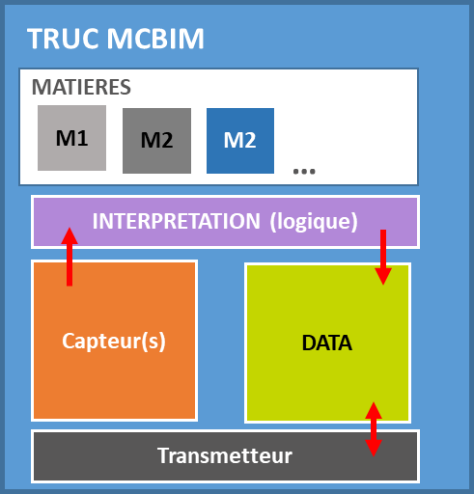
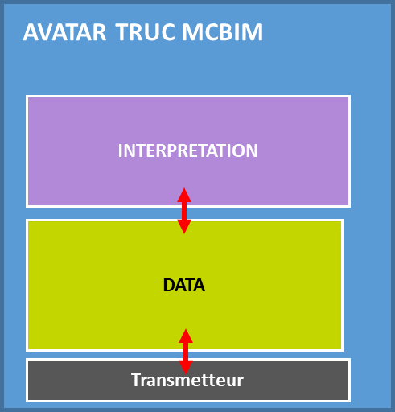
Rappel de la structure cible du projet McBIM
FT4
MONDE REEL
MONDE DIGITAL
Echanges cryptés
ENVIRONNEMENT
Physique et réglementaire
Données
ENVIRONNEMENT SI Extérieurs
BIM, ERP, PLM …
Configuration du réseau
FT5
TRUC MCBIM
AVATAR TRUC MCBIM
MATIERES
M1
M2
M2
INTERPRETATION
…
FT3
INTERPRETATION (logique)
Capteur(s)
FT2
DATA
INTERNE
+ ID TRUC à minima
FT3
DATA INTERNE & EXTERNE
Mode
Automatique
(via gateway?)
Transmetteur
Transmetteur
FT1
FT1
ENVIRONNEMENT SI McBIM
(Traitements, intelligence)
Sur sollicitation
(Collectes de données, surveillance)
FT4
Objectif de la présentation
ACTEURS

Slide 5
McBIM – Hardware architectures
Version de travail pour réunion McBIM du 09/05/2018
Issu de la présentation du LAAS du 12/04

Slide 6
Table of contents
  McBIM global architecture
    Version 1
    Version 2
  Communicating node architecture
  Sensitive node architecture
  Use case: concrete manufacturing phase
  Use case: construction phase
  Use case: operation phase
  Conclusion

Slide 7
McBIM global architecture
Version 1
There is only one Internet interface in the CN network.
NB:
Interoperability with externe smart sensors is represented.

Slide 8
McBIM global architecture
Version 2
Each CN communicate through Internet.
NB:
Interoperability with externe smart sensors is represented.

Slide 9

Choice
  V1 is preffered, but with multiple possible gateways
  To prevent network failures, redundancy is needed
  All communicating nodes have a communication interface with internet, activated or not
  Node are communicating with internet via 3G or 4G
  Network lifetime >= 50 years
  Communication distance between nodes:
    Distance between communicating nodes : 20 m
    Distance between SN and CM : 20m

Slide 10
Communicating node architecture

Slide 11
Communicating node architecture
  Main constraints and hypothesis
    Ideally, communicating nodes are located at the interface between concrete and air
    Ideally, wire networks (main supply and ethernet) are available in operation phase and batteries need in construction one
    CN are reliable, efficient, secure, reprogrammable (in term of network processing – change in measurement frequencies, transmission frequencies), capable of computation and low cost
    Eithers CN communicate between them and one of them interfaces Internet or all communicate only with the Internet network
    Always coupled with a NFC tag, QRcode, RFID tag for identification
    Network could be defined as a meshed multipoint network
Notes:
Interface : emplacement CN en limite de matière … peut-être juste l’antenne ?

Slide 12
Communicating node architecture
  Key technical elements
    Antenna and telecommunication module
      Which frequency? (function of electromagnetic properties of reinforced concrete and techno dependent)
      Which technology? (LoRa, UWB, BLE,,... function of range, data rate,...)
      Security given by the chosen technology
      Interoperability with a mobile phone must be supported
      4G could be a candidate.
    MCU
      What kind of processing element? (microcontroller, processor, DSP, FPGA, ASIC,…)
      What kind of process? (calculi, check, signal processing, reprogrammable)
      What quantity of process? (few, much more,…) dependant of the phase (Relatively low)
    Communication module: User and Internet interfaces
      Transfer can be differential or total.
      Which latency is tolerable? → No real time constraints
      What kind of security? Authentication mechanism? Blockchain ? (LE2I – techno/phase dependent)
    DC Power / PMU
      Main supply is available for CN In operational phase but not in construction and before

Slide 13
Communicating node architecture
  Optional elements
    Sensors
      What kind? (temperature, humidity, corrosion, strain, cracks, location (ou alors localisation relative à un scan),…)
      What technology? No idea → we ask concrete manufacturers?
    Memory
      How much? Standards sizes ?
      What kind? (RAM, ROM, flash,…)
      What for? (distributed data storage, reprogrammable, local buffer,...) Query/response BIM’s DB
    WPT
      What frequency?
      What kind of antenna? (wideband, multiband,…)
    Energy storage
      How much? (in terms of time, processing,…) / Which autonomy?
      What for? (fabrication period, power supply failure,…) construction also – a lot of “empty” periods …
Notes:
NRJ : Temps entre fabrication … livraison … utilisation en construction (quelques mois ?)

Slide 14
Sensitive node architecture

Slide 15
Sensitive node architecture
  Main constraints and hypothesis
    Sensitive nodes are embedded inside reinforced concrete
    Reliability, energy autonomy and efficiency, cost are main targeted objectives
    Ideally, SN do not embedded processing capacities and memories (not reprogrammable and not real nodes from ICT point of view)
    Ideally, a generic platform will be developed, on which all kind of sensors could be used
    SN communicate only with a local CN
    Network could be defined as a centralized star network
    No Reception
    Density : 2/3 m3 max?

Slide 16
Sensitive node architecture
  Key elements
      How modify parameters of use?
    Sensors
      What kind? (temperature, humidity, corrosion, strain, cracks, location,…)
      What technology? No idea … see WP2 SoTA v1
    Interface: from sensor to telecommunication
    Antenna and telecommunication module
      Which frequency? (function of electromagnetic properties of reinforced concrete)
      Which technology? (LoRa, UWB, BLE, homemade,… function of range, data rate,...)
      What kind of security? communication inside the concrete is not secure → communication and data security..
    DC Power / PMU
      Is EH feasible?
      Is WPT a better alternative?
      How much energy is needed? Depend of the kind of sensor and sensing frequency
      How often must SN capture and transfer data? Depend of the phase (low data rate qq octets/h). 1 data transfer/ h/ sensor is enough?
Notes:
La sollicitation des Capteurs doit être reconfigurable … dépend de la phase (ex: humidité importante pour la livraison d’une poutre)
De même la fréquence d’interrogation ou de capture de données doit être modulable (variation conso énergie)
Grande antenne (affleurant la limite du béton) ?
Range : longueur max poutre (dizaine de mètres jusque quelques centaines) mais surtout à l’intérieur de la matière
Low data rate (quelques octets par h)

Slide 17
Sensitive node architecture
  Optional elements
    MCU
      What for? Maybe primary filtering …
    Memory
      How much? Very low
      What kind? (RAM, ROM, flash,…),
    WPT
      What frequency? (same as for communication,...) use of WiFi ? 4G ? …
      What kind of antenna? (wideband, multiband,…) 100kHz ? Size of the antenna?
    Energy storage
      How much? (in terms of time, processing,…) with WPT: 30 years …
      What for? (fabrication period, power supply failure,…) operational phase ; depend of the kind of sensor

Slide 18
Use case: concrete manufacturing phase
  SNs and CNs are required
  Regular measurements are needed, but low data rate.
  The electromagnetic properties of concrete fluctuate greatly with variations in water concentration:
    Are telecommunication and WPT feasible?
  Desired data: temperature, humidity, location

Slide 19
Use case: construction phase
  The use of CNs is sufficient
  Embedded energy is necessary
  Long (to internet), and medium or short (to local user) range communications are required
  What kinds of data are desired? How often?
    Some are limited in terms of data rate and energy consumption (temperature, humidity, strain), others not (corrosion (if non-destructive sensor), cracks detection and location)

Slide 20
Use case: exploitation phase
  SNs and CNs are required, maybe with additional external sensors (interoperability)
  Ethernet and main supply links are needed
  What kinds of data are desired? How often?
    Some are limited in terms of data rate and energy consumption (temperature, humidity, strain), others not (corrosion (if non-destructive sensor), cracks detection and location)

